Slide 1

Today’s Agenda
Universal shift registers
Asynchronous counters: Ripple counter
Synchronous counters

Slide 2
Universal Shift Register
A₃
A₂
A₁
A₀
S₁
CLR
S₀
USR
SR_{in}
I₃
I₂
I₁
I₀
SL_{in}
Mode Control |  | Register Operation
S₁ | S₀
0 | 0 | No change
0 | 1 | Shift right
1 | 0 | Shift left
1 | 1 | Parallel load

Slide 3
Universal Shift Register
A₃
A₂
A₁
A₀
Q
Q
Q
Q
D
D
D
D
CLR
CLK
S₁
S₀
S₁
S₀
Y
MUX
3 2 1 0
SI for SR
SI for SL
I₃
I₂
I₁
I₀

Slide 4
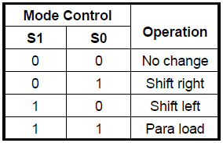

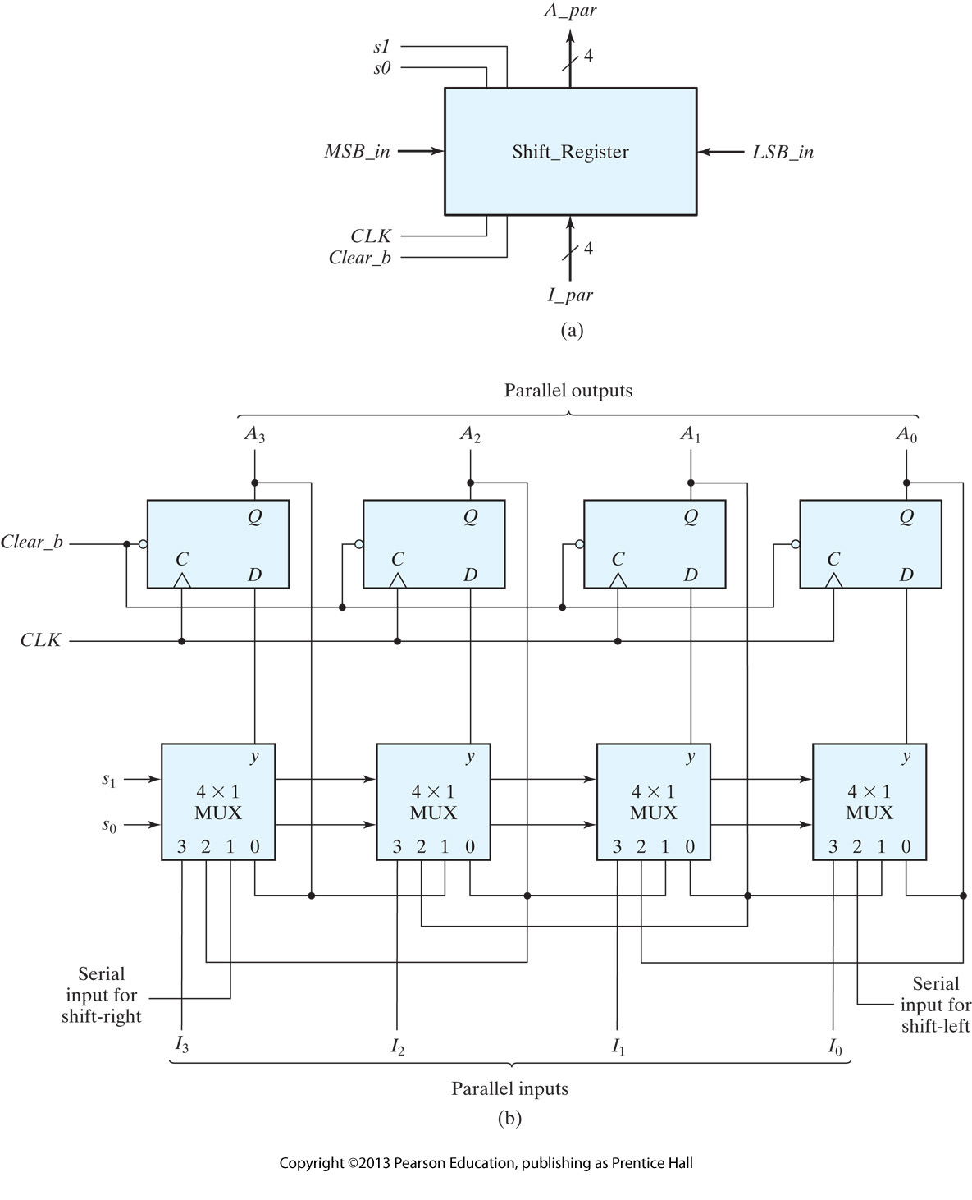
Universal Shift Register:

Slide 5
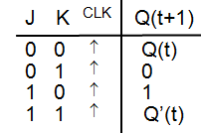

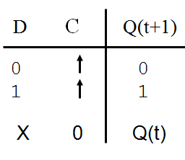
Complementing Flip Flops
The next state of these flip flops is complement of present state.
They can constructed using T, J-K and D flip flops.

Slide 6
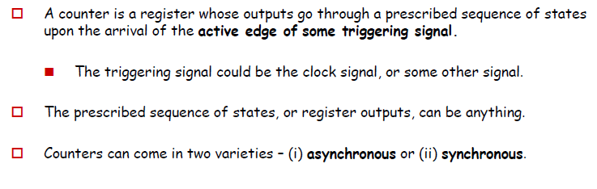
Counters:

Slide 7
Ripple Counter (asynchronous Counter)
Ripple counters consist of a series of flip-flops where the output Q of one flip-flop is used (somehow) as the clock for the next flip-flop.
It is the lack of a common clock signal for each flip-flop that makes the counter asynchronous.
Not all flops change value simultaneously
  Lower-order flops change first

Slide 8
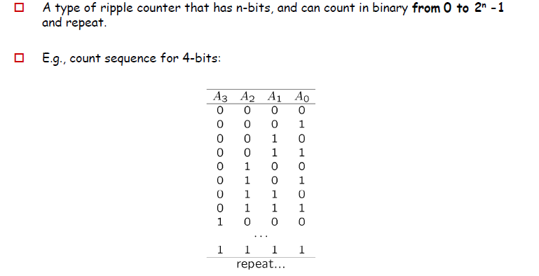
Binary Ripple Counter

Slide 9
Binary Ripple Counter
We can make a binary ripple counter easily via observation…
A₀ always flips…
A₁ flips with A₀ goes 1 to 0…
A₂ flips with A₁ goes 1 to 0…
Etc…
So, the i-th bit goes 1 to 0 , (i+1)-th bit flips.

Slide 10
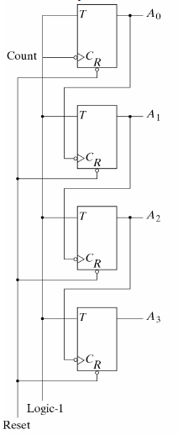
Binary Ripple Up Counter
Binary Ripple Counter with TFF

Slide 11
Binary Ripple Counter
If T=1,
Q(t+1) = Q’(t)
Ripple ↔ Asynchronous
A₃
A₂
A₁
A₀
Q
T
1
Q
T
1
Q
T
1
Q
T
1
CLK
CLR
CLR
CLR
CLR
CLR
CLK
A₀
A₁
A₂
A₃

Slide 12
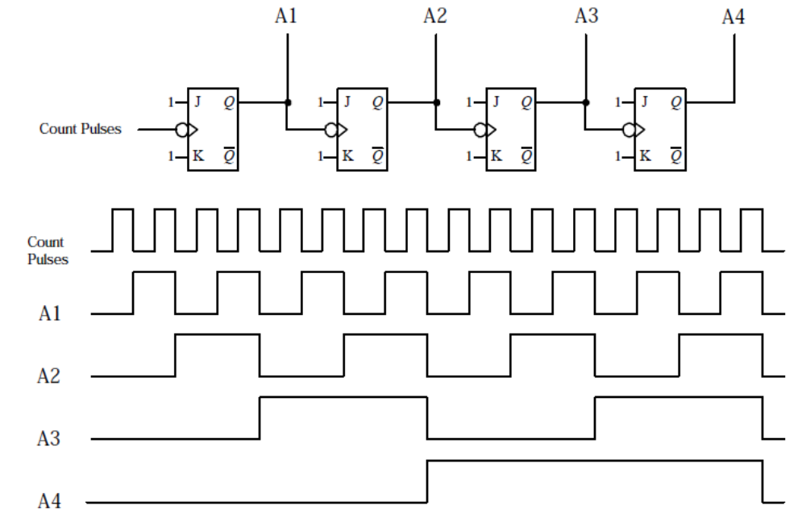
Binary Ripple Counter

Slide 13

Binary Ripple Counter
A₃
A₂
A₁
A₀
Q
D
Q
D
Q
D
Q
D
CLK
Q
Q
Q
Q
CLK
A₀
A₁
A₂
A₃

Slide 14
Binary Ripple Counter
A₃
A₂
A₁
A₀
Q
D
Q
D
Q
D
Q
D
CLK
Q
Q
Q
Q
CLK
A₀
A₁
A₂
A₃
0
1
2
3
4
5
6
7
8
9

Slide 15
Binary Ripple Down Counter
BINARY UP COUNTERS:
A counter that counts 0, 1, 2, L , 2^{n}-1 and repeats.
BINARY DOWN COUNTERS:
A counter that counts 2^{n}-1, L , 2, 1, 0 and repeats.
In down counter:
A₀ always flips…
A₁ flips with A₀ goes 0 to 1…
A₂ flips with A₁ goes 0 to 1…etc.
So binary ripple down counter diagram looks like same as binary ripple up counter diagram (shown in previous slides) provided all flip flops are positive edge trigerred.

Slide 16
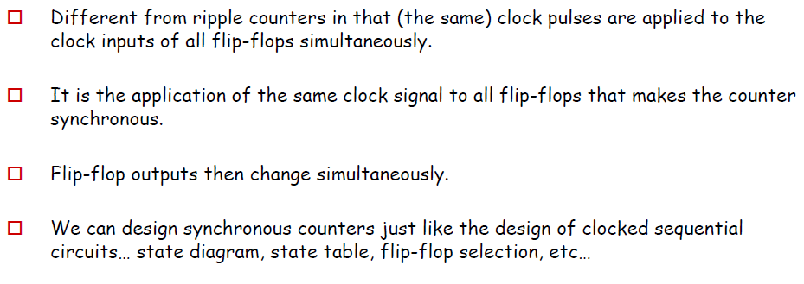
Synchronous Counters

Slide 17
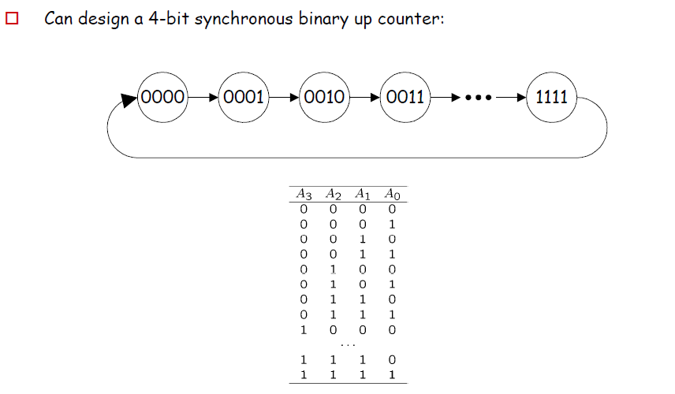
Synchronous Binary Counter-Up Counter

Slide 18
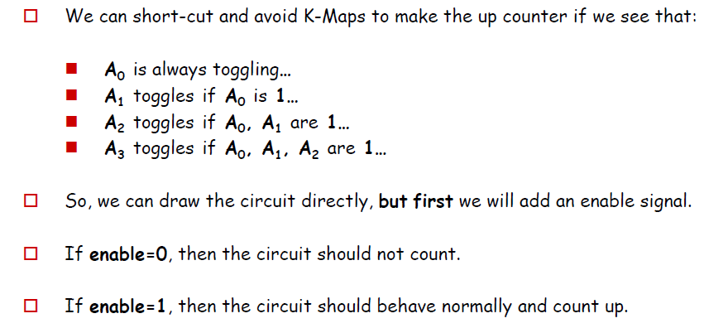
Synchronous Binary Counter-Up Counter

Slide 19
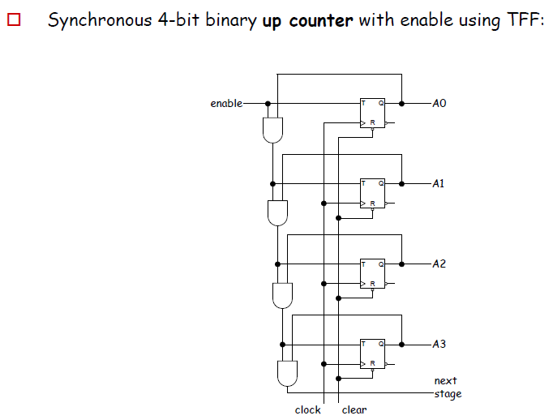
Synchronous Binary Counter-Up Counter

Slide 20
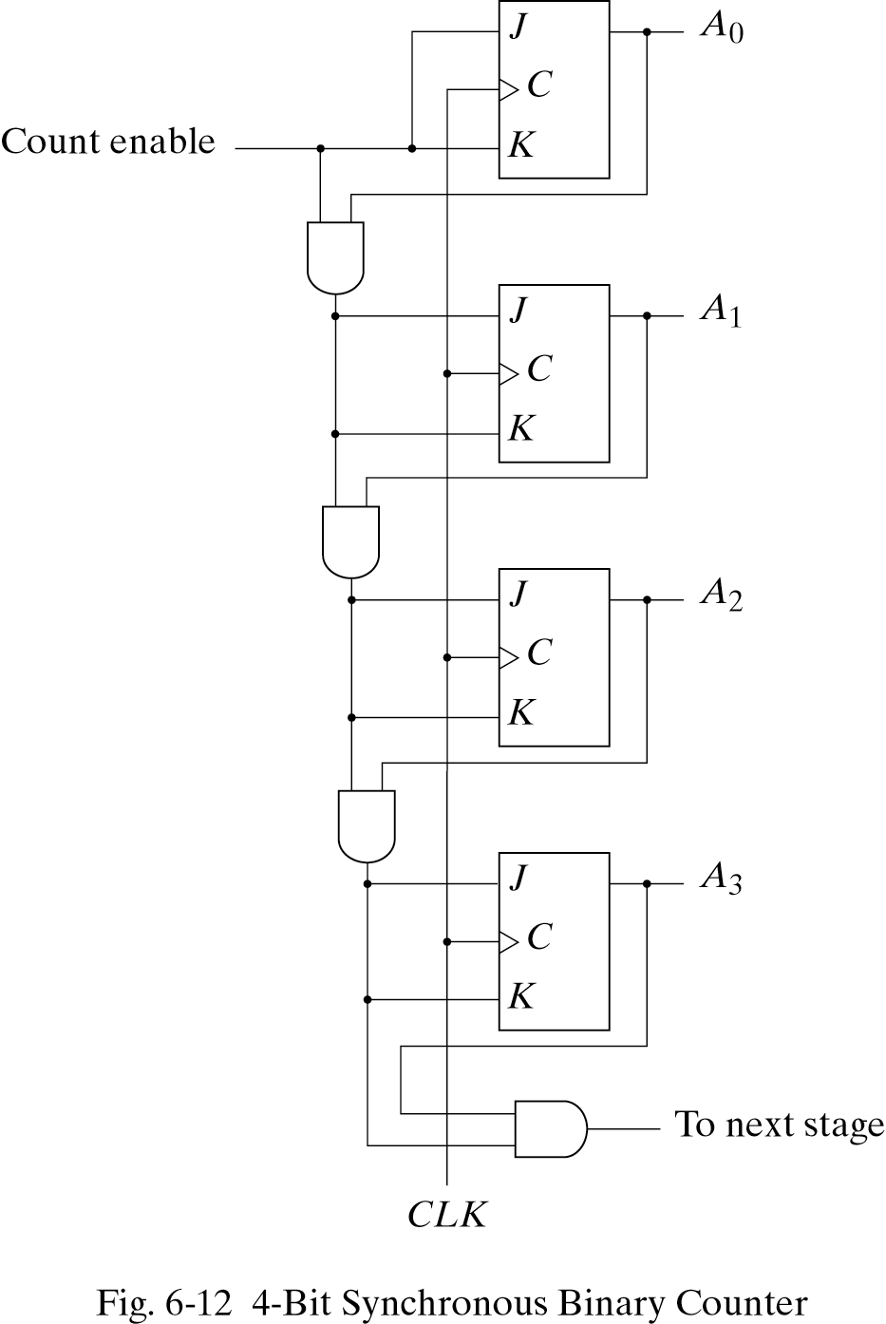
Synchronous Binary Counter-Up Counter
Designed with JK FF

Slide 21
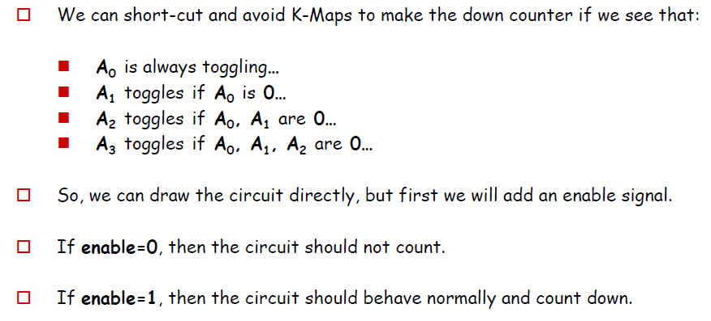
Synchronous Binary Counter-Down Counter

Slide 22
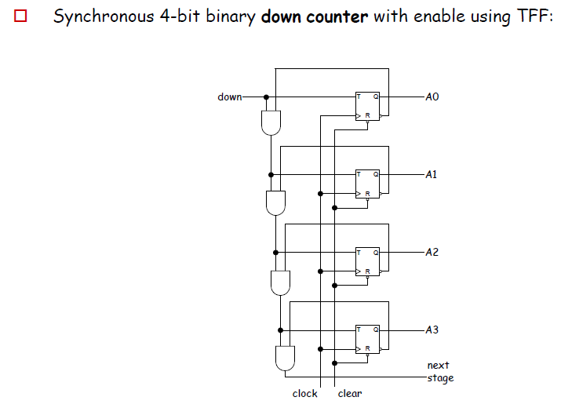
Synchronous Binary Counter-Down Counter

